Slide 1











1. List the Roles found on WAY Cards. 2. Why should teachers be fair to students? 3. What does WAY stand for?
Answer It
1. Teaching a class about WAY Cards. 2. That’s so unfair. 3. The best WAY Games are___ and ___.
Act It
1. A Self-Portrait. 2. A WAY Card. 3. the WAY Game Logo.
Draw It
Spell It
1. Mystery. 2. Transcripts. 3. Essential.
Question It
1. WAY Card. 2. Calgary. 3. A Place Card.
1. Is Random Select of students for tasks fair? 2. What’s better in class, raise your hand, or select students with WAY Cards. 3. Why be happy?
Speak It
1. Fastest to deal WAY [or Game} Cards into two teams. 2. Create a Rap called NO WAY. 3. Rock Paper Scissors winner chooses activity.
Move It
Name ______________________ Date / / % _____
1. List the Roles found on WAY Cards. 2. Why should teachers be fair to students? 3. What does WAY stand for?
Answer It
1. Teaching a class about WAY Cards. 2. That’s so unfair. 3. The best WAY Games are___ and ___.
Act It
1. A Self-Portrait. 2. A WAY Card. 3. the WAY Game Logo.
Draw It
Spell It
1. Mystery. 2. Transcripts. 3. Essential.
Question It
1. WAY Card. 2. Calgary. 3. A Place Card.
1. Is Random Select of students for tasks fair? 2. What’s better in class, raise your hand, or select students with WAY Cards. 3. Why be happy?
Speak It
1. Fastest to deal WAY [or Game} Cards into two teams. 2. Create a Rap called NO WAY. 3. Rock Paper Scissors winner chooses activity.
Move It
Name ______________________ Date / / % _____
1. List the Roles found on WAY Cards. 2. Why should teachers be fair to students? 3. What does WAY stand for?
Answer It
1. Teaching a class about WAY Cards. 2. That’s so unfair. 3. The best WAY Games are___ and ___.
Act It
1. A Self-Portrait. 2. A WAY Card. 3. the WAY Game Logo.
Draw It
Spell It
1. Mystery. 2. Transcripts. 3. Essential.
Question It
1. WAY Card. 2. Calgary. 3. A Place Card.
1. Is Random Select of students for tasks fair? 2. What’s better in class, raise your hand, or select students with WAY Cards. 3. Why be happy?
Speak It
1. Fastest to deal WAY [or Game} Cards into two teams. 2. Create a Rap called NO WAY. 3. Rock Paper Scissors winner chooses activity.
Move It
Name ______________________ Date / / % _____

Slide 2
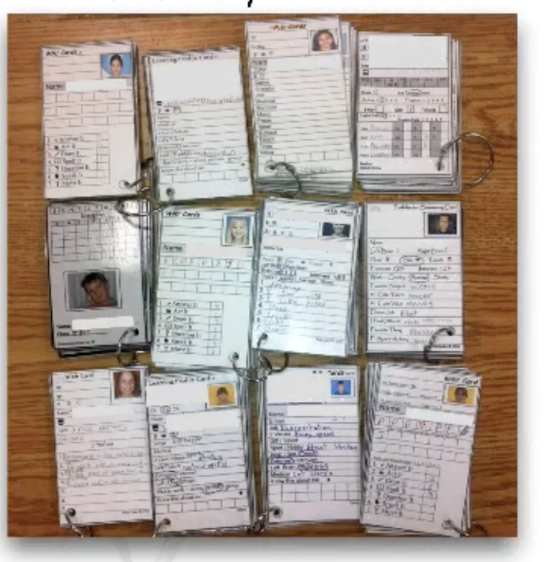
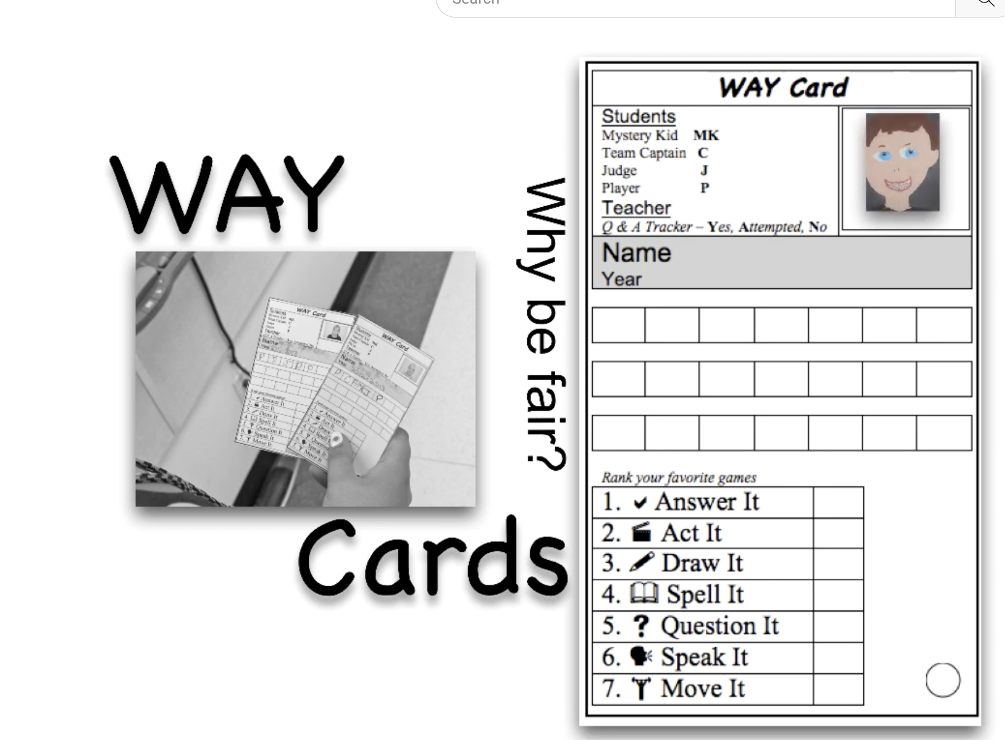

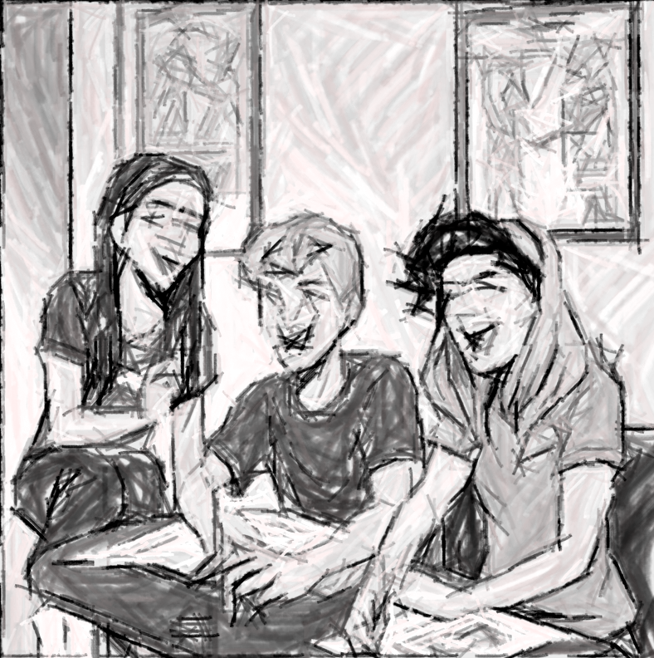
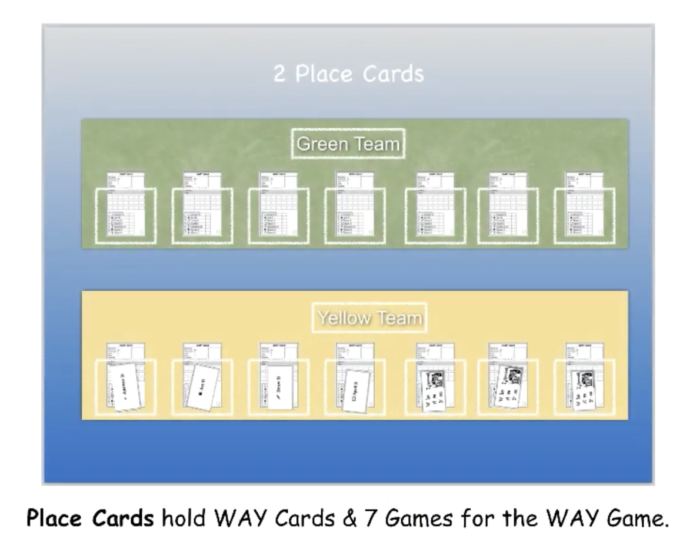

playway.ca
WAY Cards
playway.ca
WAY Cards
playway.ca
WAY Cards

