Slide 1
Answer It
1 ____to ____ in the classroom 2 List ways learning improves with aSWtL. 3 What three things are happening to teachers?
1 Counsel a depressed friend. 2 Someone teaching the WAY Game. 3 Directing a puppet play.
Act It
1 The WAY Game Logo. 2 CAP Note Logo. 3 A single CAP Note.
Draw It
Spell It
1 Acronym. 2 Mnemonics. 3 Transparent.
Question It
1 the WAY Game. 2 SMART Digital Lesson Planning, 3 Calgary
Speak It
1 aSWtL. 2 Innovation in education. 3 Student Entrepreneurs.
Move It
1 Best Tai Chi demo. 2 Sing a song - your choice. 3 Any Target Game you invent.
Name ________________________ Date / / % _____
Answer It
1 ____to ____ in the classroom 2 List ways learning improves with aSWtL. 3 What three things are happening to teachers?
1 Counsel a depressed friend. 2 Someone teaching the WAY Game. 3 Directing a puppet play.
Act It
Draw It
1 The WAY Game Logo. 2 CAP Note Logo. 3 A single CAP Note.
Spell It
1 Acronym. 2 Mnemonics. 3 Transparent.
Question It
1 the WAY Game. 2 SMART Digital Lesson Planning, 3 Calgary
Speak It
1 aSWtL. 2 Innovation in education. 3 Student Entrepreneurs.
Move It
1 Best Tai Chi demo. 2 Sing a song - your choice. 3 Any Target Game you invent.
Name ________________________ Date / / % _____
Answer It
1 ____to ____ in the classroom 2 List ways learning improves with aSWtL. 3 What three things are happening to teachers?
1 Counsel a depressed friend. 2 Someone teaching the WAY Game. 3 Directing a puppet play.
Act It
1 The WAY Game Logo. 2 CAP Note Logo. 3 Best CAP Note.
Draw It
Spell It
1 Acronym. 2 Mnemonics. 3 Transparent.
Question It
1 the WAY Game. 2 SMART Digital Lesson Planning, 3 Calgary
Speak It
1 aSWtL. 2 Innovation in education. 3 Student Entrepreneurs.
Move It
1 Best Tai Chi demo. 2 Sing a song - your choice. 3 Any Target Game you invent.
Name ________________________ Date / / % _____

Slide 2
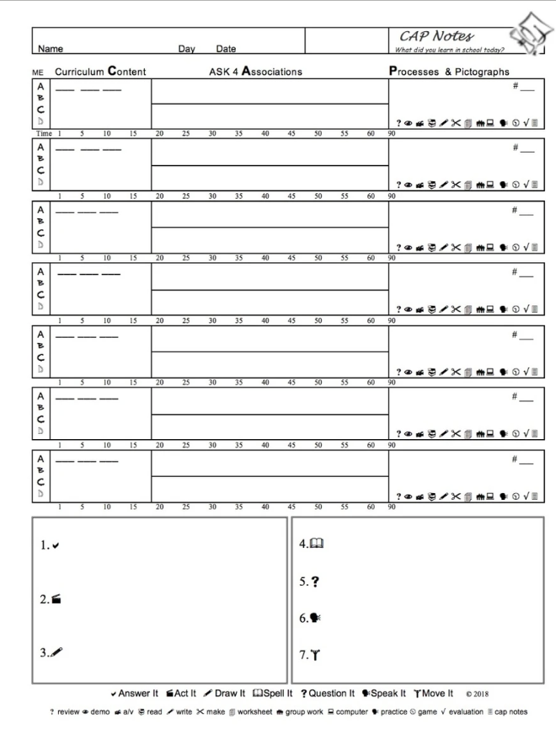
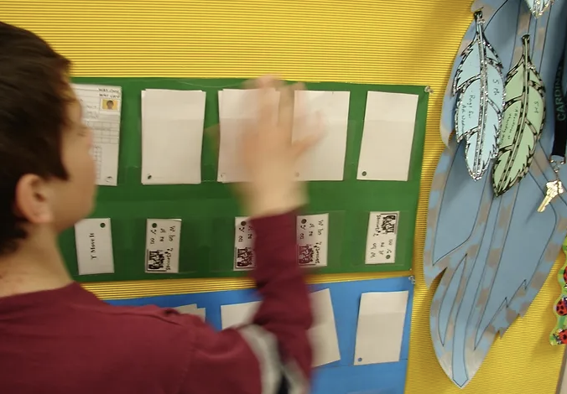
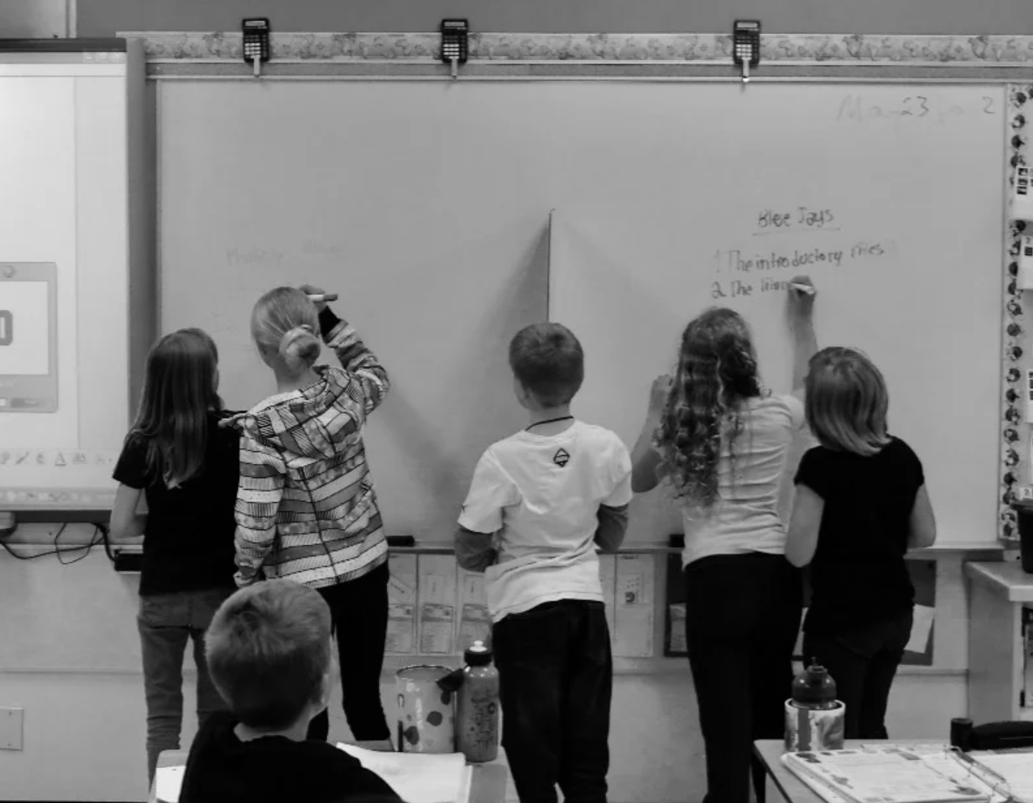
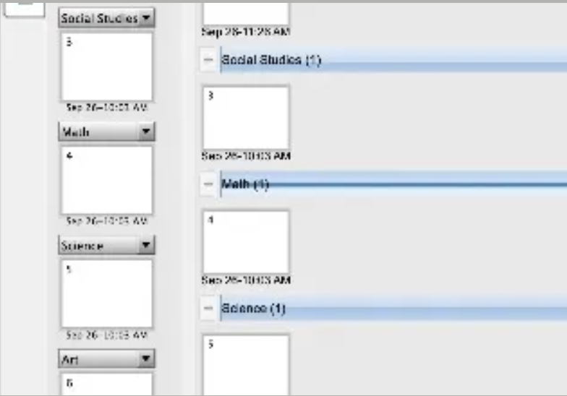
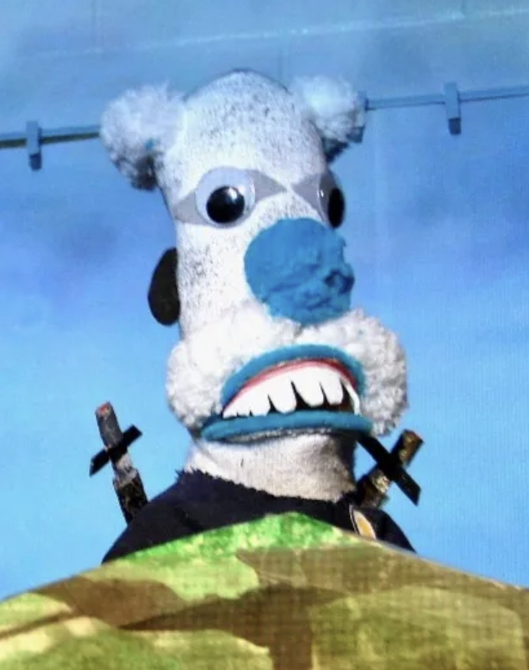
Track What You Learn?
Track What You Learn?
Track What You Learn?

