Slide 1
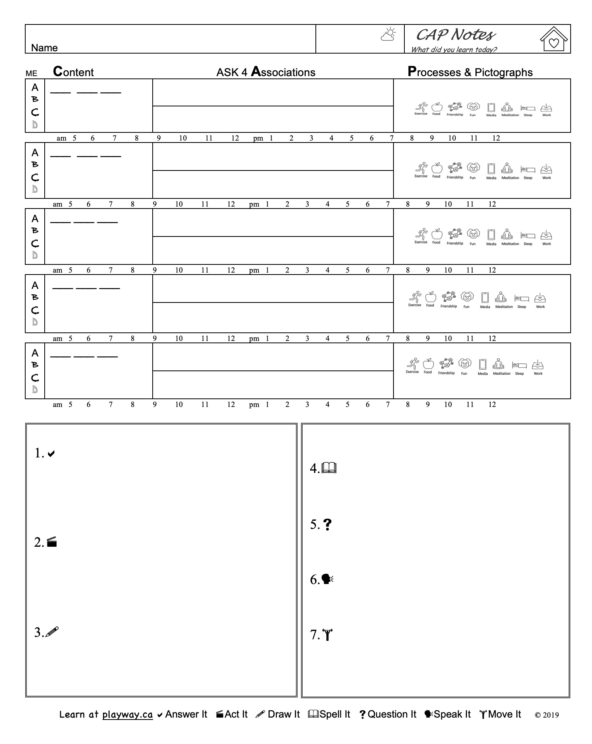


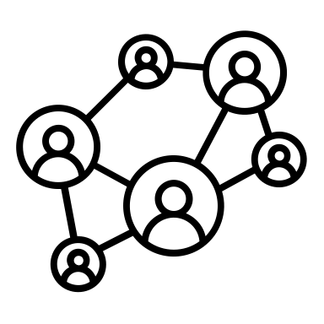





Exercise
Food
Friendship
Fun
Media
Meditation
Sleep
Work

